Slide 1
Supernormal Stimuli
September 20th, 2023
Shimojo Lab meeting

Slide 2
Agenda
What are supernormal stimuli (SNS)
SNS in humans
Peak-shift effect
Experimental design
Results
Future directions

Slide 3
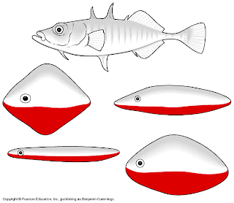
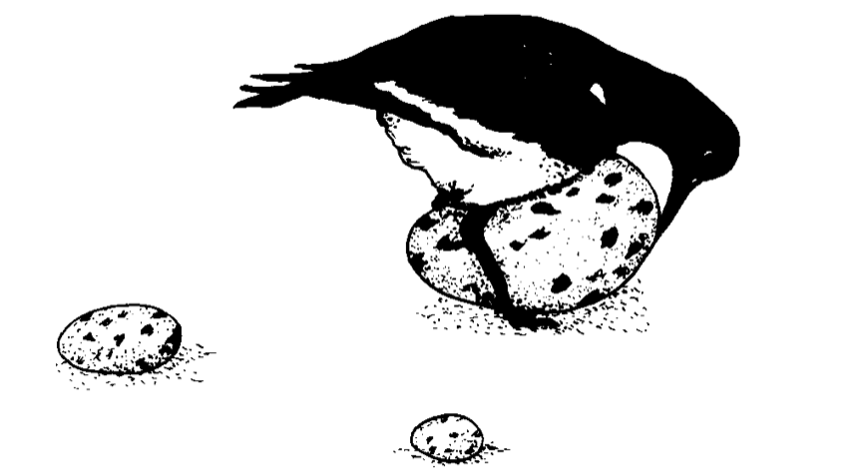
What are supernormal stimuli (1)
Oystercatcher
Stickleback fish
Tinbergen, 1949; Tinbergen & Perdeck 1950; Tinbergen, 1989

Slide 4
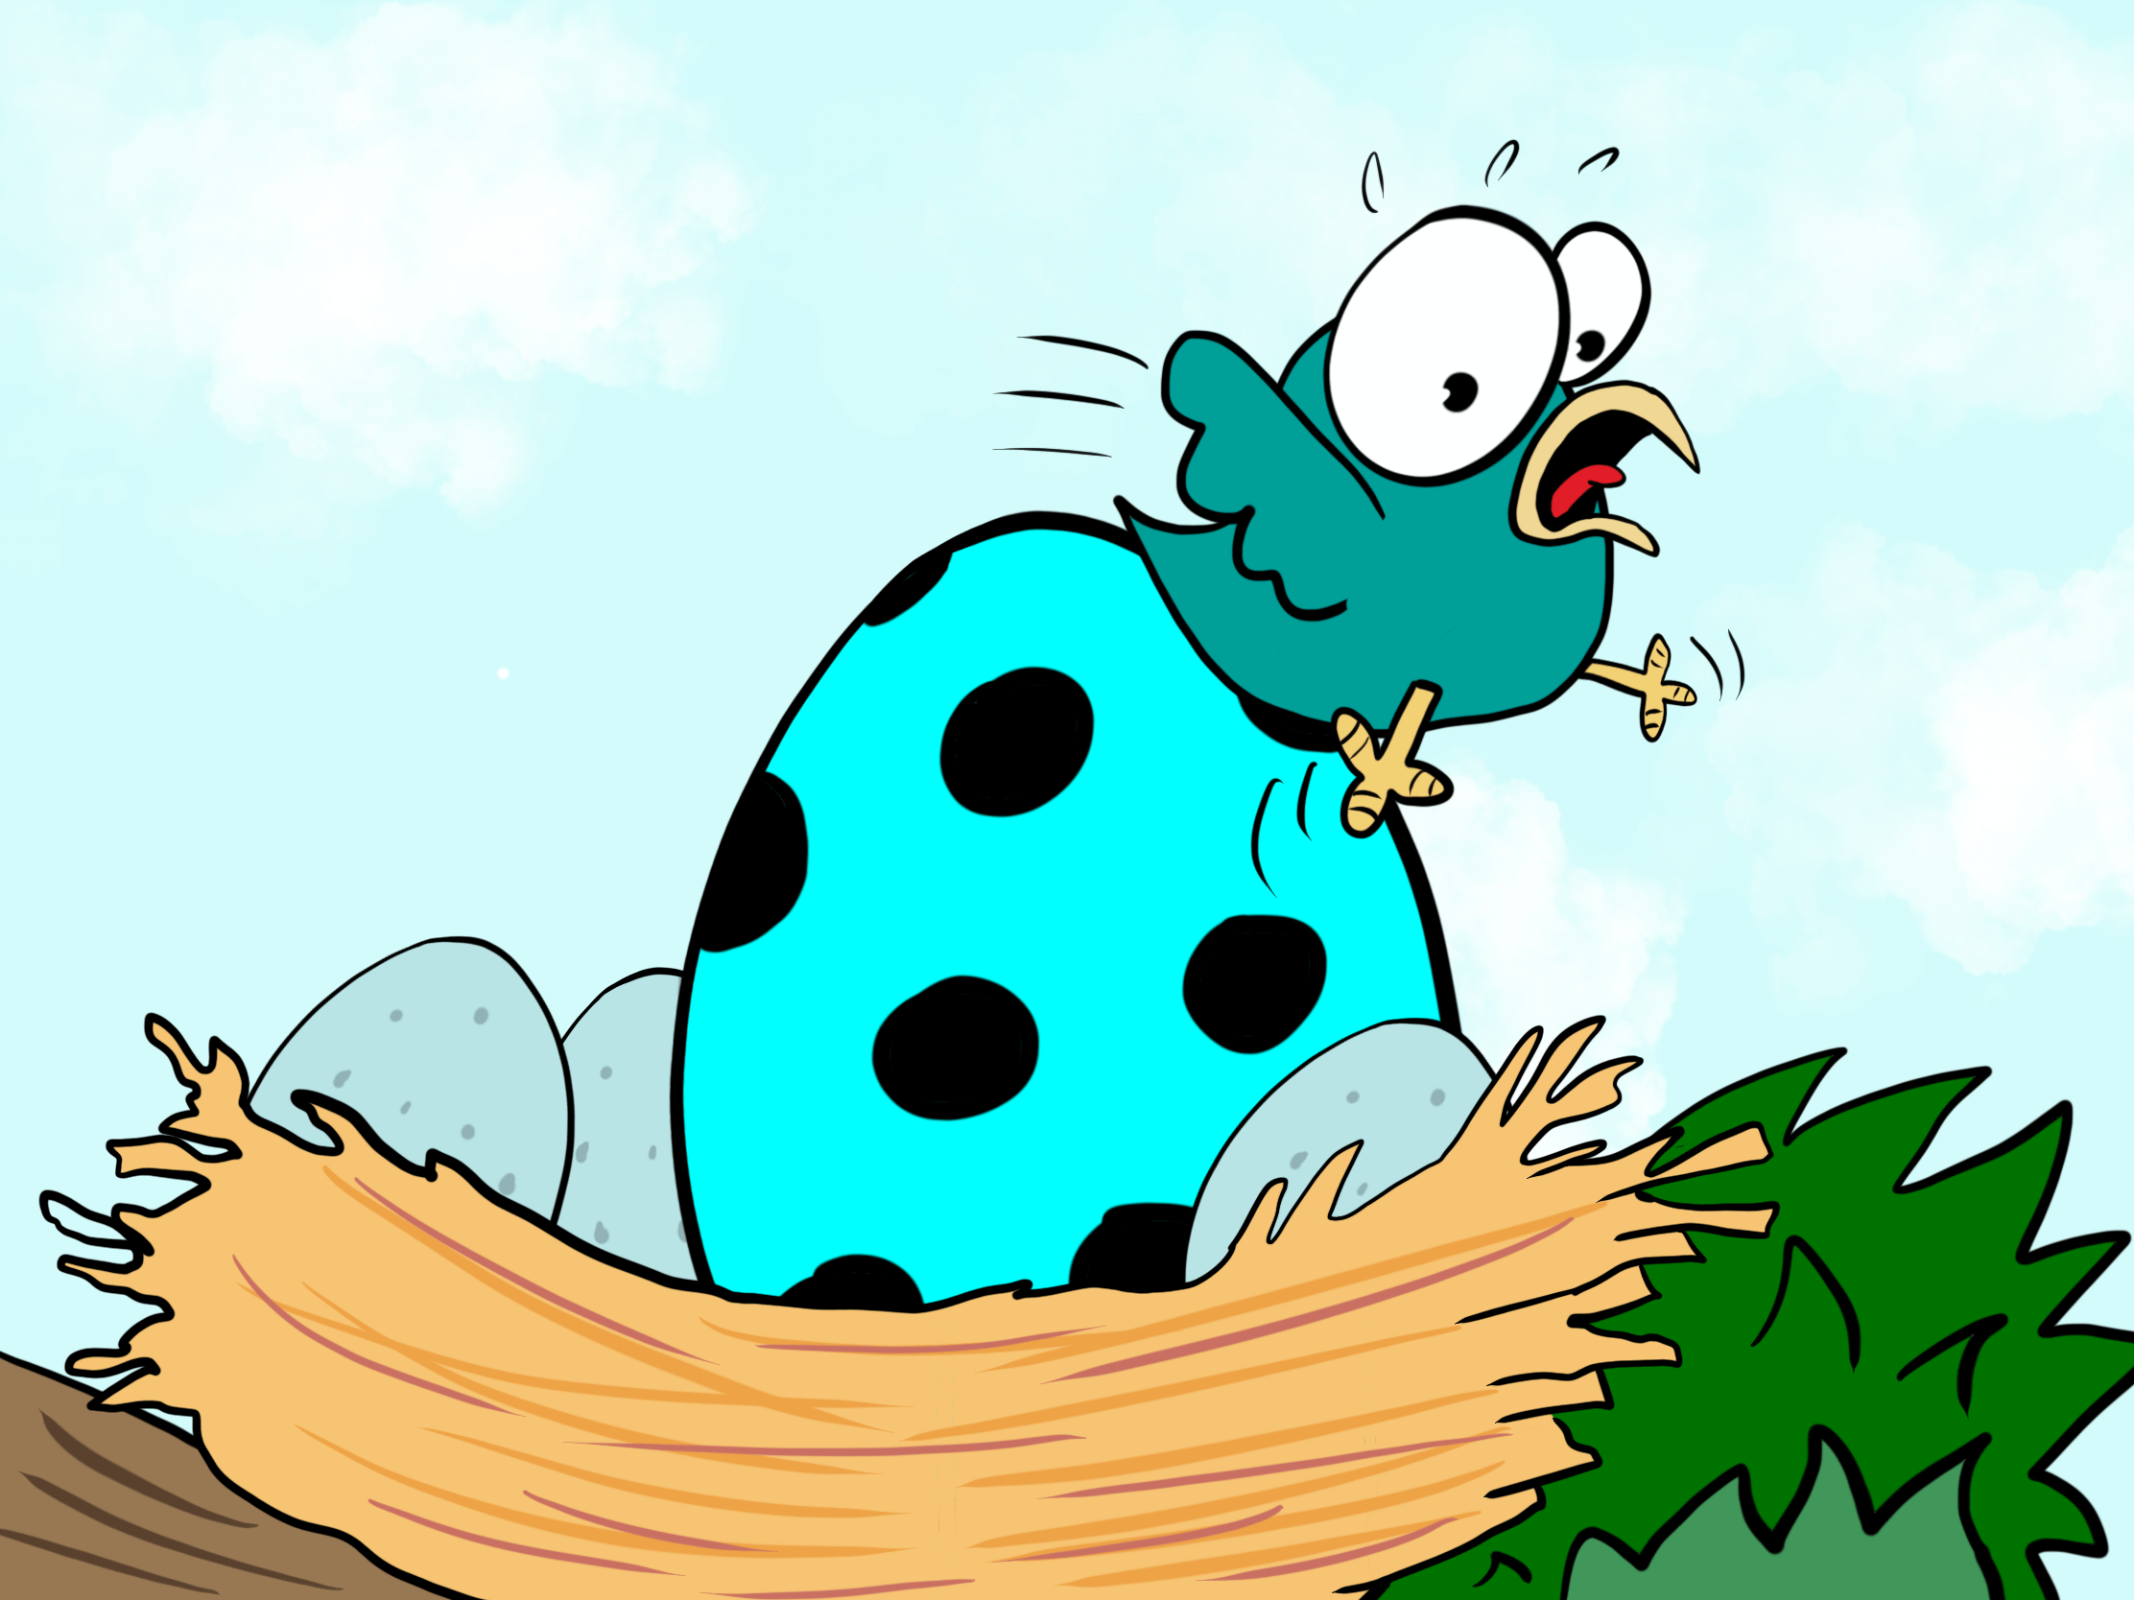
What are supernormal stimuli (2)
SNS are (artificial) stimuli that possess exaggerated levels of highly valued attributes found in nature, often beyond the objective value of the natural stimuli themselves.
Generalization → reactions to novel stimuli different than familiar ones where reactions are known (Ghirlanda, 2002, p. 389)
Evolutionary adaptation ideal, but not mandatory

Slide 5
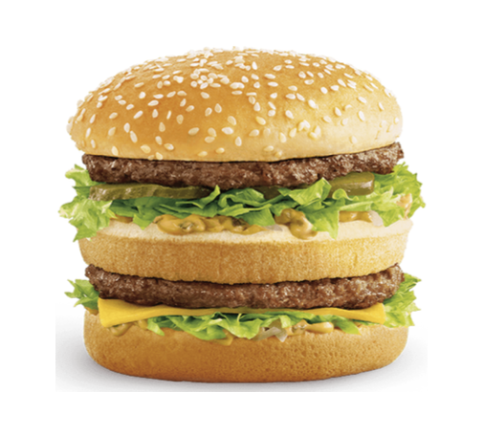
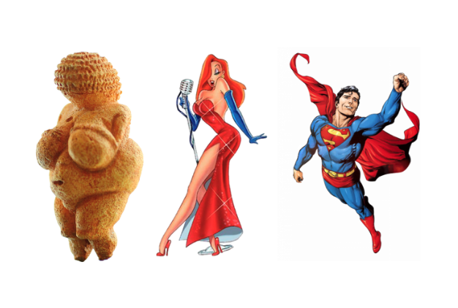

Supernormal stimuli in humans
Evolutionary mismatch → we can bypass natural instincts using cognitive overrides, but weaknesses can be exploited using technology
Why? It generates profit
Notes:
Sex: Marketable:
Make-up for eyes and cosmetics for face
Cosmetic surgery (breast augmentation, liposuction)
Gym-related – supplements, steroids
Instagram filters to change features
Food: we seek high fat and sugar foods (hard to find)
High sugary foods → short-term bouts of energy (ripe fruit)
High fat foods → associated with protein and energy storage
Preference for colored and attractive foods that denote ripeness
Danger: Horror movies, superhero movies Social media: Feeling of belonging to groups → social integration as evolutionary cue for survival

Slide 6


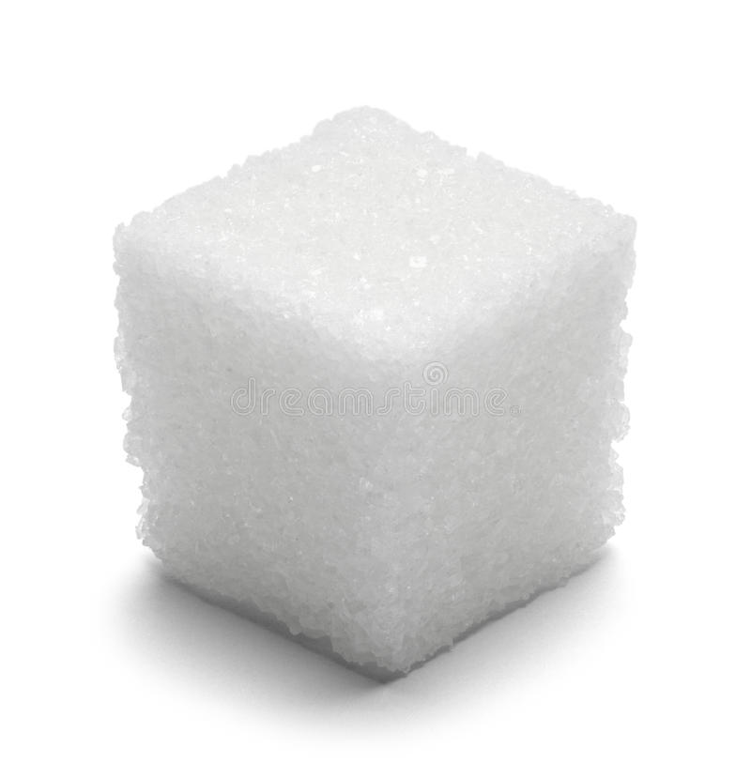
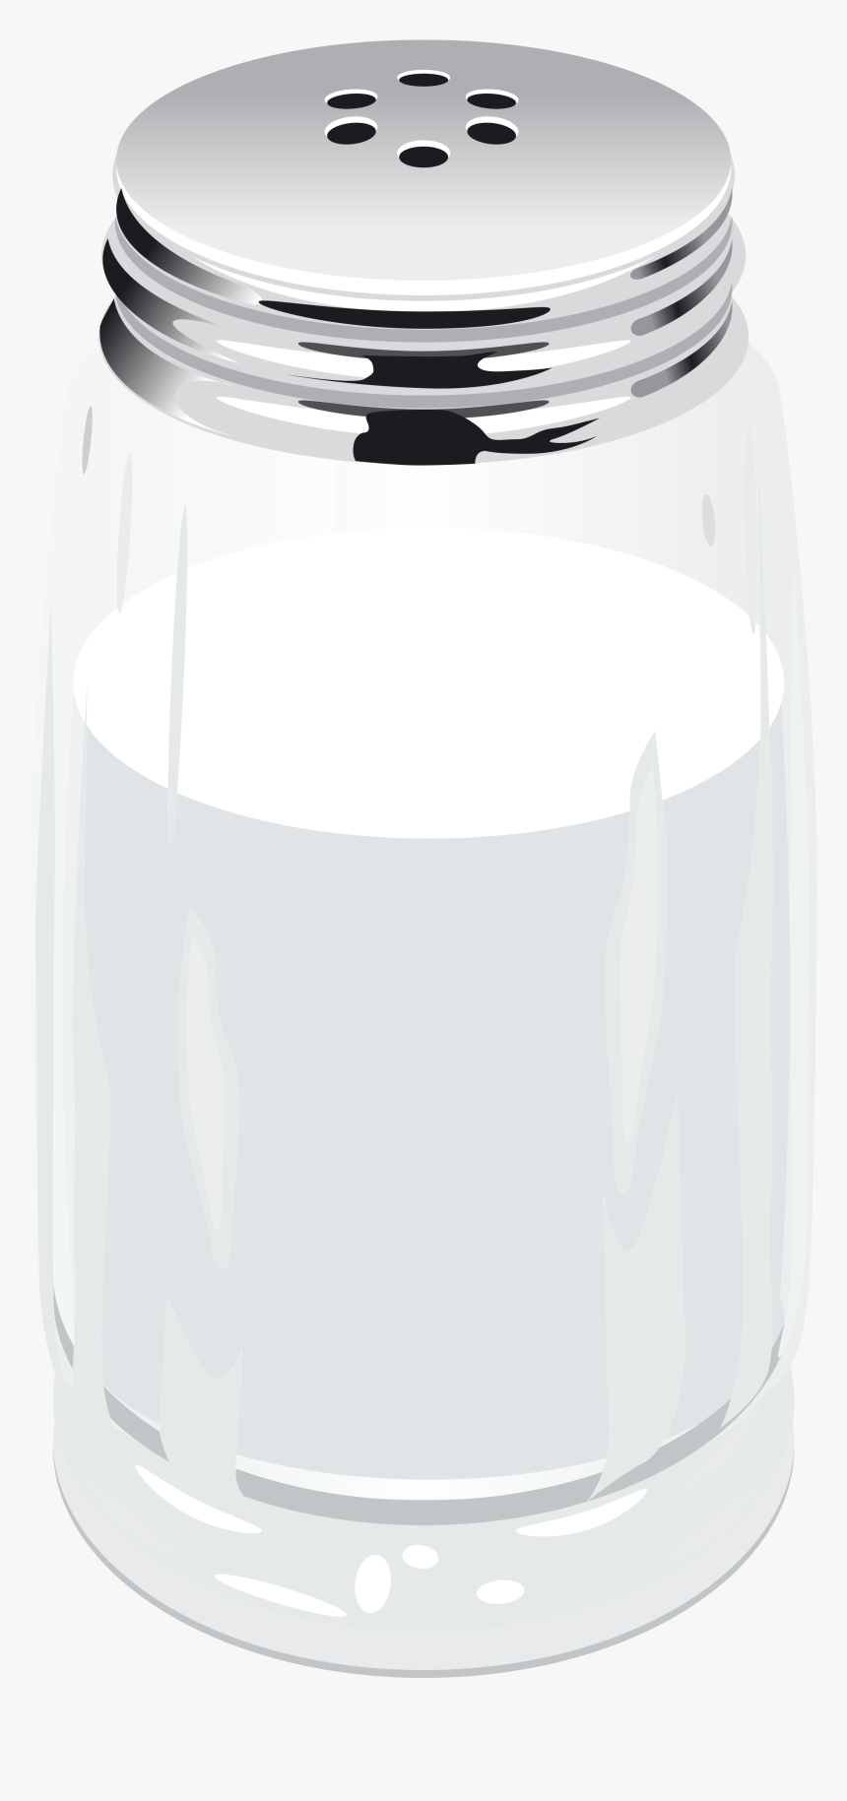
Peak-shift effect and SNS
Re-arrangement dimensions → object shape, orientation or location
Intensity dimensions → intensity of sound, color, light or other
S+ only
Both S- and S+
S-
S+
Lynn et al. (2010) Encyclopedia of Animal Behavior
Ghirlanda (2002)

Slide 7
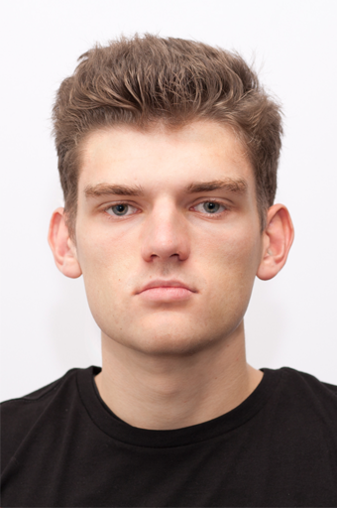
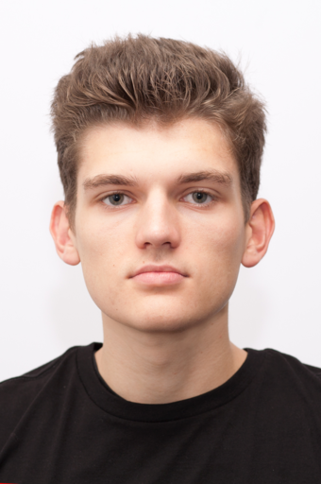
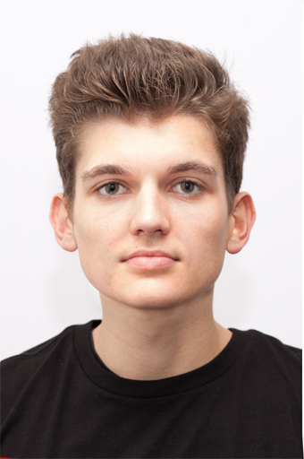
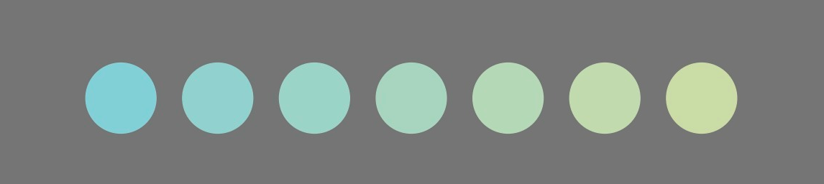
Artificial (evolutionary) stimuli
Faces and perception of warmth & competence (as proxy for safety/danger)
Fiske et al. (2007)
Walker et al. (2019)
2. Colors

Slide 8



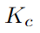
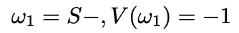
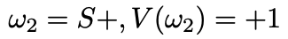
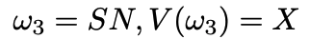
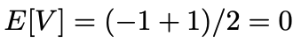
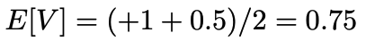
Peak-shift model
8/18
Notes:
1_Original.png

Slide 9
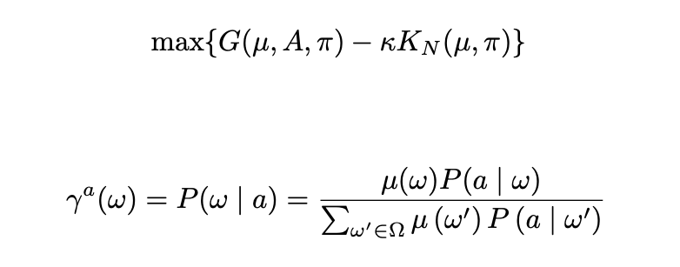
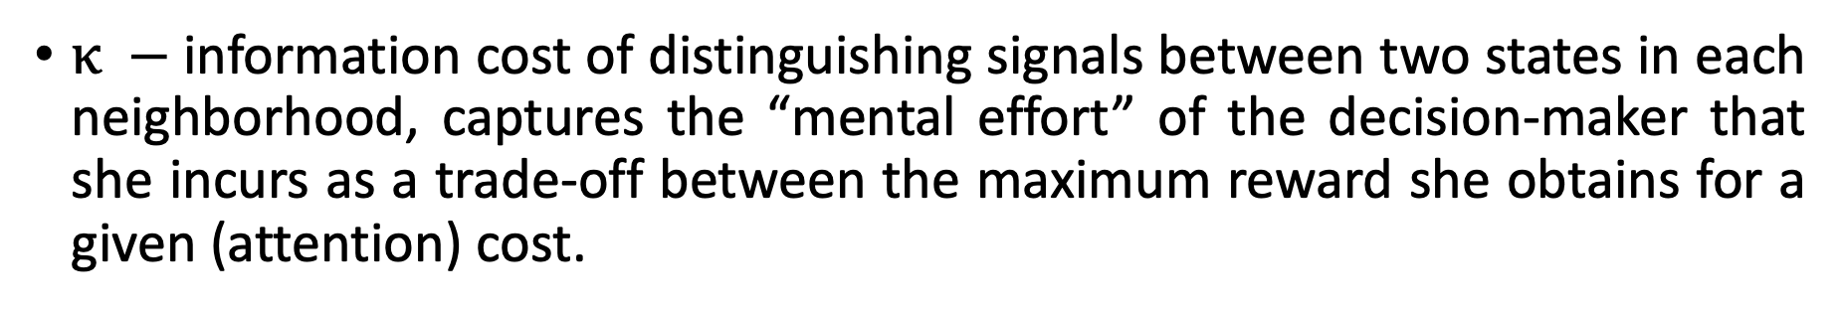
Rational inattention
$κ −$information cost of distinguishing signals between two states in each neighborhood, captures the “mental effort” of the decision-maker that she incurs as a trade-off between the maximum reward she obtains for a given (attention) cost.
9/18

Slide 10
Theoretical predictions faces
10/18
Notes:
1_Original.png

Slide 11
Theoretical predictions circles
0
-0.5
-1
+1
+0.5
0
0
-0.5
-1
+1
+0.5
0
11/18
Notes:
1_Original.png

Slide 12
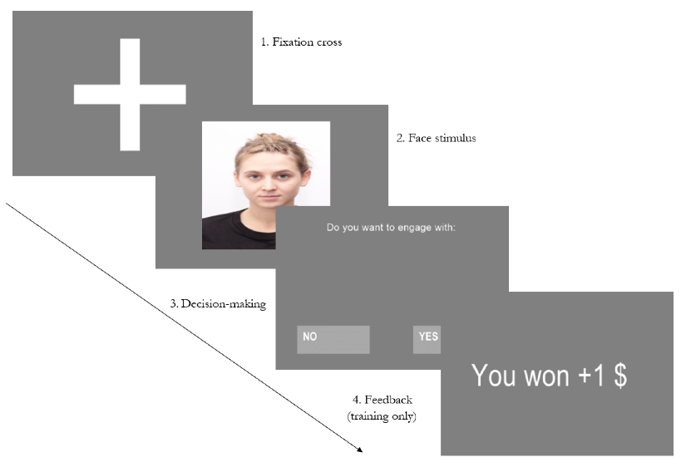
Experimental design
1. Training (conditioning) phase → reward is shown
2. Testing phase → reward not shown
Pilot data
Faces:
Stimuli: 60 training, 120 testing
Participants 29 (W) and 20 (C)
Circles:
Stimuli: exposure without decision 18 trials, 18 training, 96 testing
Participants: 15
Working memory task before
12/18

Slide 13
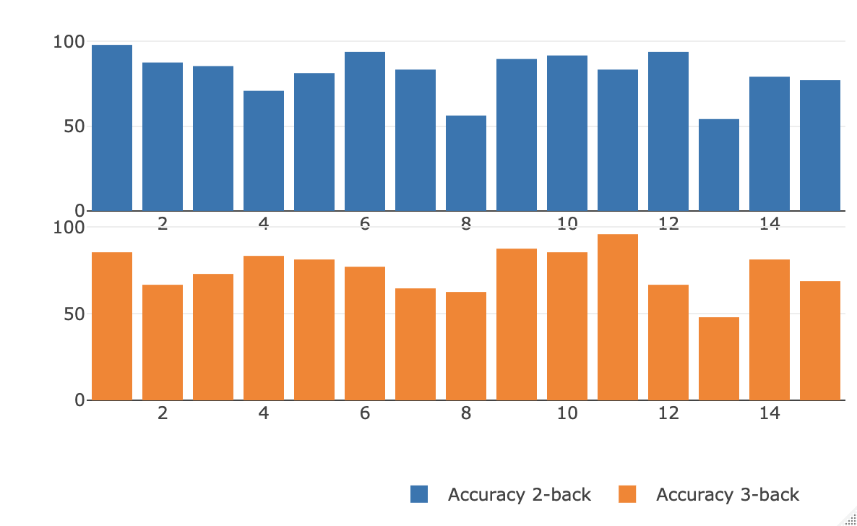
Working memory results circles
Average accuracy 2-back = 81.6%
Average accuracy 3-back = 75.1%
 | Accuracy 2back | Accuracy 3back | Circle 1 | Circle 2 | Circle 3 | Circle 4 | Circle 5 | Circle 6
Accuracy 2back | 100% | 56% | 10% | -22% | -25% | -16% | -19% | -36%
Accuracy 3back | 56% | 100% | -42% | -60% | -1% | 30% | 32% | 13%
13/18

Slide 14
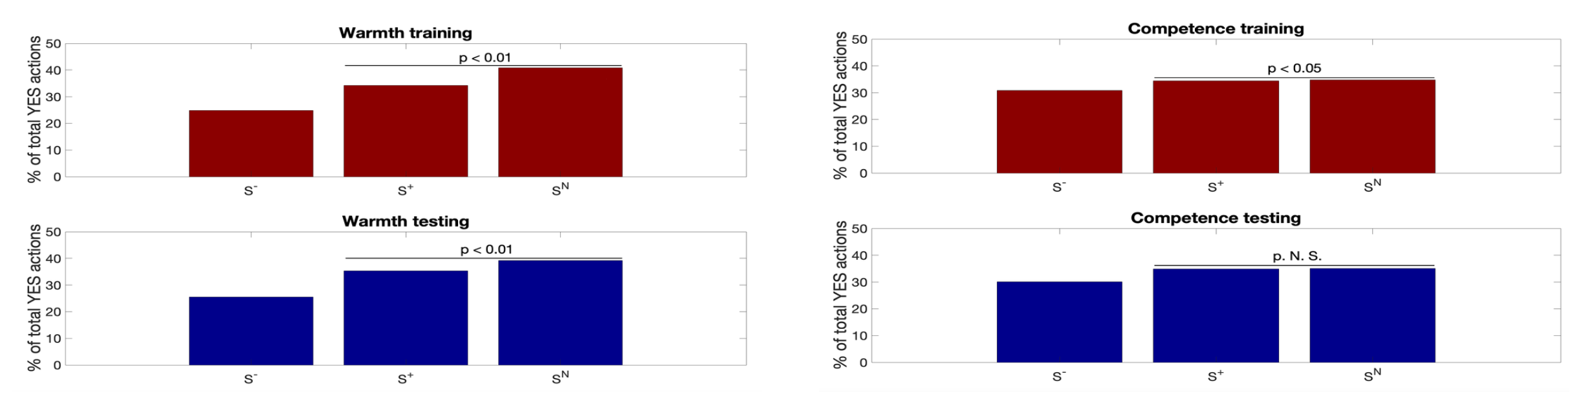
Results W&C
Warmth
Competence

Slide 15
Results W&C
Warmth
Competence
-1
+1
+0.5
-1
+1
+0.5
15/18
Notes:
Proportion of total YESes / total choices for ONE state

Slide 16
Results circles
0
-0.5
-1
+1
+0.5
0
16/18

Slide 17
Suggestions, directions
Eye-tracking?
vs.
1
6
3
4
vs.
1
3
2
3

Slide 18
Thank you

